Slide 1
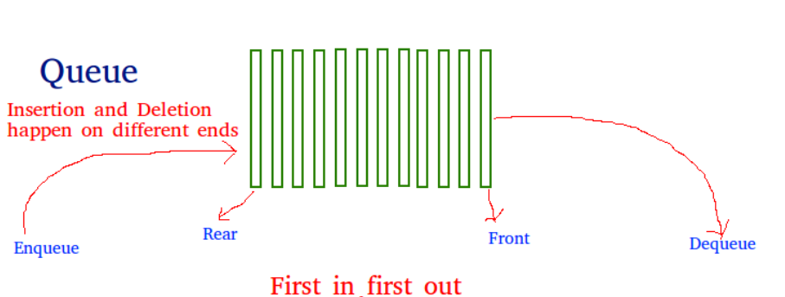
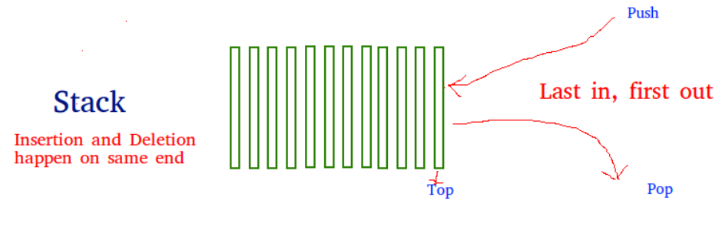
Queue using Stack
A queue is a FIFO (First In First Out).
while a stack is a LIFO (Last In First Out) data structure.
A stack pushes a new element to the top of the stack and also pops the element at the top. A queue, however, dequeues (removes) an element from the Rear end of the queue, ​but it enqueues (inserts) an element at the Front end .

Slide 2
Reasons :
Space Efficiency
Enqueue Operation Efficiency
Dequeue Operation Efficiency
Simplicity of Implementation
Flexibility in Choosing Data Structures
For example, in scenarios where memory usage is a critical factor, implementing a queue with stacks might be more advantageous than using a linked list.
In summary, implementing a queue using two stacks is a trade-off between space efficiency and simplicity of implementation. It can be a suitable choice in scenarios where memory efficiency and a straightforward implementation are important considerations.

Slide 3
Applications
Task Scheduling in Operating Systems
Undo Mechanism in Software Applications
Print Queue Management
Backtracking Algorithms
Simulation of Queues in Environments with Limited Resources
In these applications, the use of two stacks to simulate a queue provides a practical and efficient way to manage and process data in a queue-like manner, taking advantage of the simplicity and efficiency of stack operations.

Slide 4
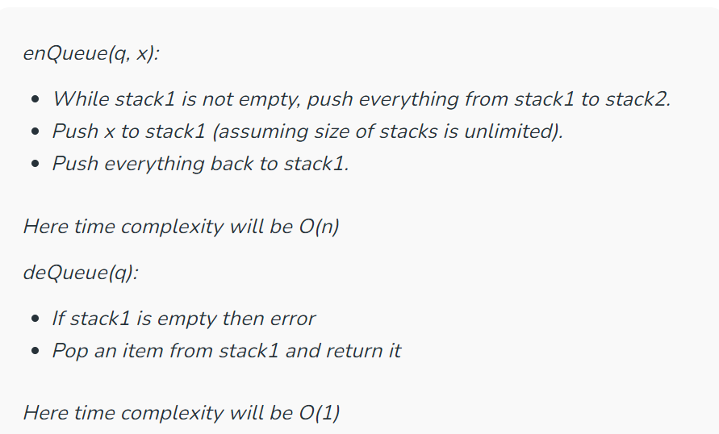
Approaches for implementing queue using Stack A queue can be implemented using two stacks.
Method 1 (By making enQueue operation costly):
This method makes sure that oldest entered element is always at the top of stack 1, so that deQueue operation just pops from stack1. To put the element at top of stack1, stack2 is used.

Slide 5
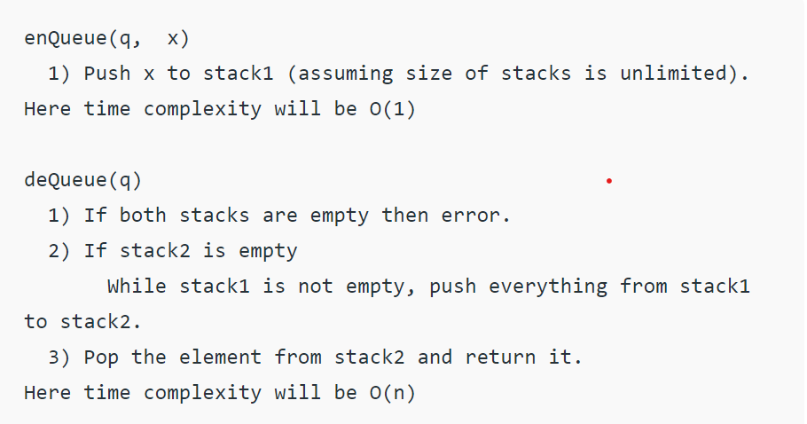
Method 2 (By making deQueue operation costly):
In this method, in en-queue operation, the new element is entered at the top of stack1. In de-queue operation, if stack2 is empty then all the elements are moved to stack2 and finally top of stack2 is returned

Slide 6
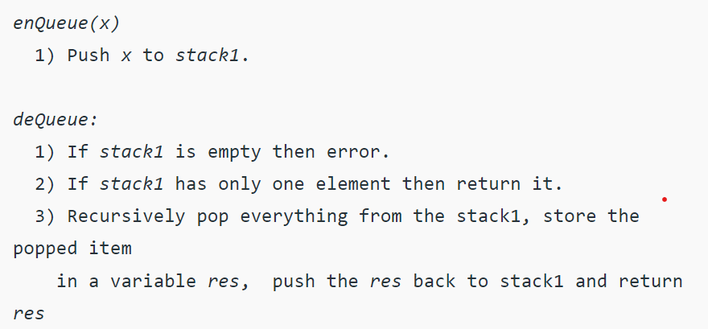
Queue can also be implemented using one user stack and one Function Call Stack.
Below is modified Method 2 where recursion (or Function Call Stack) is used to implement queue using only one user defined stack

